Slide 1



DETECTING FRAUDULENT TRANSACTIONS

Slide 2

AGENDA
OBJECTIVE
BACKGROUND STUDY
DATASET
METHODOLOGY
RESULTS AND DISCUSSION

Slide 3
OBJECTIVE
TO FIND “STRANGE” TRANSACTION REPORTS THAT MAY INDICATE FRAUD ATTEMPTS BY SOME OF THE SALESPEOPLE.
TO HELP IN THE TASK OF VERIFYING THE VERACITY OF THESE REPORTS GIVEN PAST EXPERIENCE OF THE COMPANY.
OUTCOME OF THE DATA MINING PROCESS WILL SUPPORT POSTERIOR INSPECTION ACTIVITIES BY THE COMPANY.

Slide 4

4
FLOW CHART
ADVANCED RESEARCH
DETECTION OF FRAUDULENT TRANSACTIONS
A review of existing literature related to the detection of fraud transaction.
Data unification and missing value interpolation with the data.
Defining the Data Mining Tasks
Different Approaches to the Problem
Understanding new class of
data mining problems: outliers ranking
Transactions report

Slide 5
ADVANCED RESEARCH
Research paper review
Online Transaction Fraud Detection Techniques : A Review of Data Mining Approaches
The author has used 10 techniques to detect the fraud.
The commonly used fraud detection methods are decision trees, Neural Network (NN), fuzzy system, rule-induction techniques, K-Nearest Neighbour, Support Vector Machines (SVM), Artificial Immune System (AIS), genetic algorithms. These techniques can be used alone or in collaboration to build classifiers using meta-learning approaches [1]

Slide 6

DATASET
30% TESTING SET
70% TRAINING SET
401,146
OBSERVATION
ID
Prod
Quant
Val
VARIABLES
Insp
CATEGORICAL VARIABLE

Slide 7

METHODOLOGY
DATA CLEANING
Handling unknown Values
Few Transactions of Some Products

Slide 8
METHODOLOGY
DEFINING THE DATA MINING TASKS
Different Approaches to the Problem
UNSUPERVISED TECHNIQUES
SUPERVISED TECHNIQUES
SEMI - SUPERVISED TECHNIQUES

Slide 9
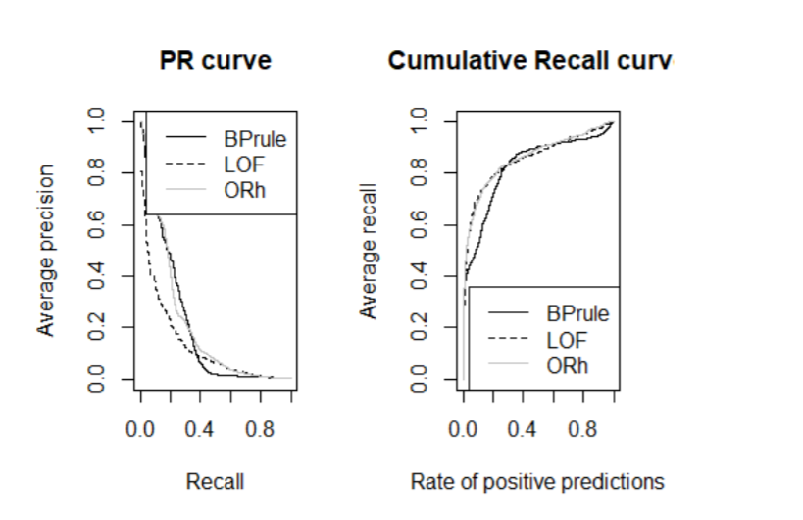
UNSUPERVISED TECHNIQUES
THE MODIFIED BOX PLOT RULE
LOCAL OUTLIER FACTORS
CLUSTERING-BASED OUTLIER RANKINGS

Slide 10
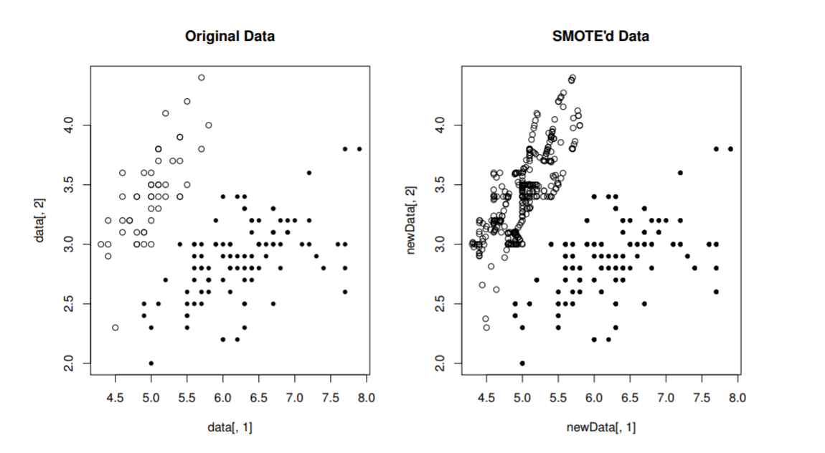
SUPERVISED TECHNIQUES
THE CLASS IMBALANCE PROBLEM
The data has 8.1 % fraudulent reports
Due to this imbalance we cannot use the regular learning models.
Solution involves,
1. Biased towards minority data
2. Sampling to change class distribution.
SMOTE : Replicate minority class and add it to the data

Slide 11
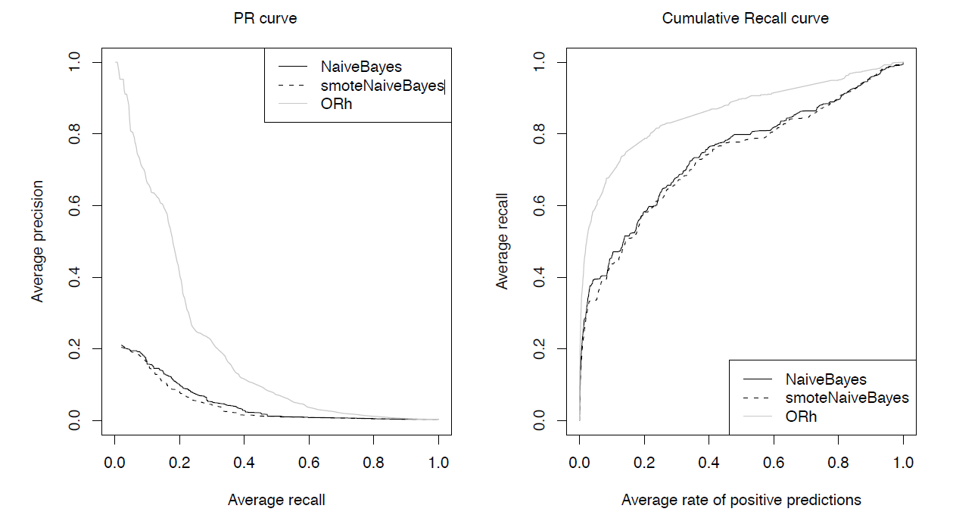
SUPERVISED TECHNIQUES
NAIVE BAYES
Uses very strong assumptions on the independence between the predictors.
Estimate probability from the training set using relative frequencies.
We obtain selected evaluation statistics for the model from the hold out routines.
Then we compare it with the naïve Bayesian model for the SMOTE’d data

Slide 12
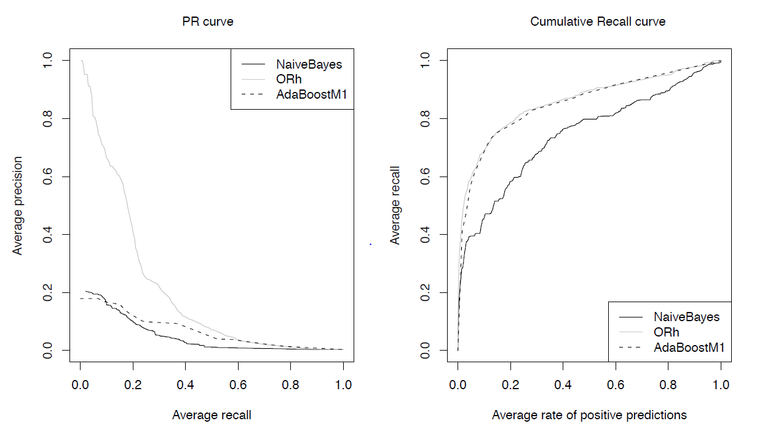
SUPERVISED TECHNIQUES
AdaBoost
Adaptive boosting method to obtain set of base models.
Increase the weight of the minority cases and forces to focus on them.
Outputs a probabilistic classification.
Recall is 69 %

Slide 13
SEMI - SUPERVISED TECHNIQUES
METHODS USED
APPROACH USED
PARAMETERS USED IN SELF TRAINING METHODS
TERMINATING SELF-TRAINING PROCESS
RESULTS

Slide 14
RESULTS AND DISCUSSIONS
Main goal of this chapter was to introduce the reader to a new class of data mining problems: outliers ranking.
We used supervised, unsupervised- and semi-supervised approaches to the problem.
In methodological terms we have introduced the reader to a few new topics:
Outlier detection and ranking
Clustering methods
Semi-supervised learning
Semi-supervised classification through self-training
Imbalanced class distributions and methods for handling this type of problem
Naive Bayes classifiers
AdaBoost classifiers
Precision/recall and cumulative recall curves
Hold-out experiments

Slide 15
REFERENCES
[1] B. B. Sagar, P. Singh and S. Mallika, "Online transaction fraud detection techniques: A review of data mining approaches," 2016 3rd International Conference on Computing for Sustainable Global Development (INDIACom), New Delhi, 2016, pp. 3756-3761.

Slide 16
THANK YOU

